Slide 1
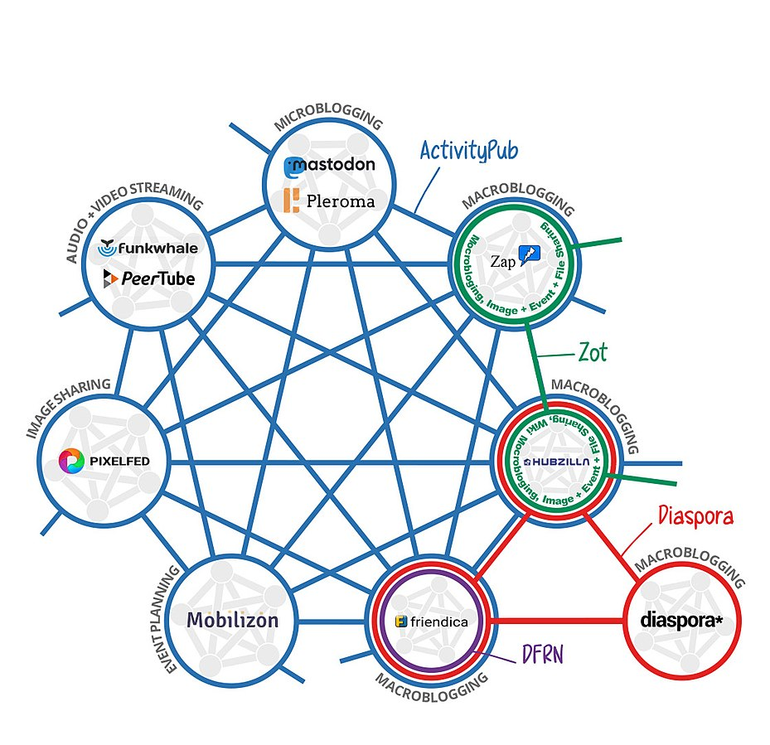

Intro
Mastodon vs other social medias
About mastodon.social: Privacy Policy
Features
Source: wikipedia

Slide 2
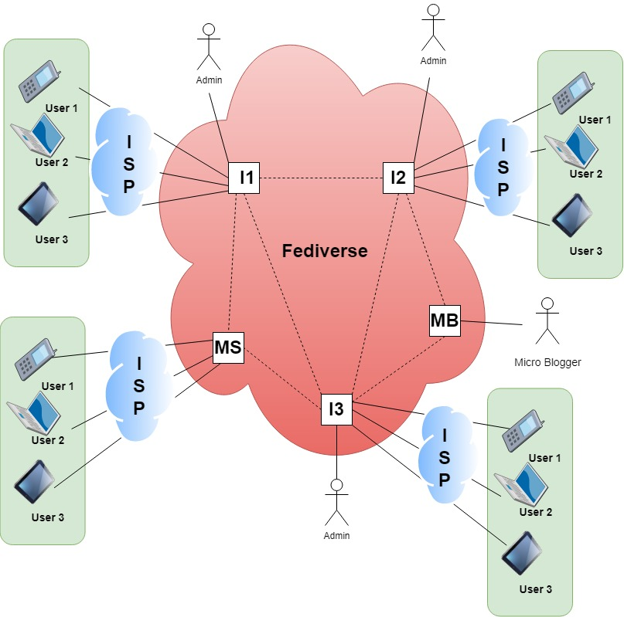
Basic System Model

Slide 3
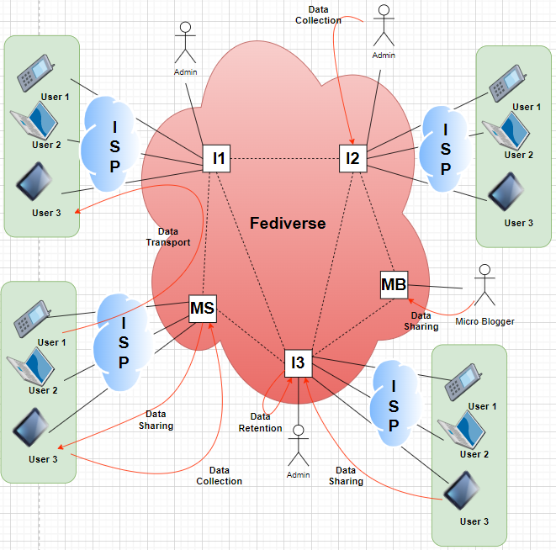
Activity 1: User and Service Domains User Domain: User Devices (Mobile, Laptop, Tablet), Micro-blogger Service Domain: Instance (Hosted by an Admin or Mastodon.Social), Fediverse Activity 2: Identification of Necessary Data User Domain: User Email Address, Direct Messages, User Toots, Instance Name. Service Domain: User Email Address, Direct Messages, User Toots, Instance Name, Email to hello@joinmastodon.org with the subject "Server submission".
By, Srinidhi & Sriram
Activity 3: Distribution of the Data in the Architecture
Threat Modeling
Data Retention
Data Leak at Rest
Data Leak at Transit
No Default End-to-End Encryption
Toot Data Disclosure
Toot Tampering
Linkability between Usernames and Instance Names
Identifiability of a user within an Instance through his/her Username
Non - Compliance
1 & 3
9
6
4
7
8

Slide 4
Solution for the threat modelling
Data retention:
Include a data privacy policy to delete the user account and its content.
Data leak at rest:
Using pseudonumization techniques
For Toot use encryption(AES256) and for the userID, use tokenization.
Data leak at transit:
Hashing the transport data from user domain to server domain.
End-to-End encryption:
Implement end-to-end encryption as the default technique.
Toot tampering:
In mastodon network, to avoid toot tampering store the hashed to one database and toot in another database.
Linkability:
To solve this create a unique username so that other user doesn’t have to know to which instance user belonging to.
Compliance-Age restriction:
This can be included by default in privacy policy. Mastodon can collect this data while registration. So that they can prevent the user to join any “NSFW” groups.

